Slide 1
CONTENTS
S. No. | Contents | Slide no.
1. | Introduction with flow chart of Hotel Management | 3,4
2. | Hardware and Software requirements | 5
3. | Description | 6,7
4. | Modules of project | 8,9,10
5. | Applications | 11

Slide 2
INTRODUCTION
The objective of the project is to computerize the Hotel Management System using Python 3.7.
We have used concepts of Object Oriented Programming System as objects and classes are used.
This project provides Graphical User Interface (GUI).
In this the User Interface (UI) is converted into Python coding Using Converter.
We have used PyQT Designer for better designing of the project.

Slide 3
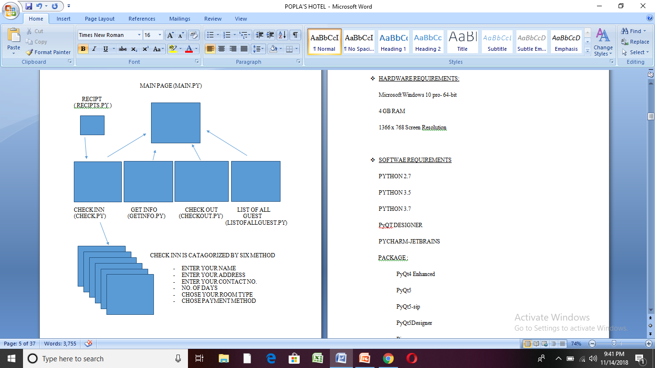
FLOW CHART OF HOTEL MANAGEMENT

Slide 4
HARDWARE AND SOFTWARE REQUIREMENTS
HARDWARE REQUIREMENTS:
Windows 10 Pro-64 bit
4 GB RAM
1366 x 768 Screen Resolution
SOFTWARE REQUIREMENTS:
Python versions 2.7 ,3.5 ,3.7
Pycharm-Jetbrains
PyQT Designer
PACKAGE :
PyQt4 Enhanced
PyQt5
PyQt5-sip
PyQt5Designer
Pip
Setup tool

Slide 5
DESCRIPTION
The hotel in this project has 50 ROOMS capacity and the rooms are categorized into four parts :
GENERAL ROOMS : It contains 20 rooms numbered from ROOM NUMBER– 26 to ROOM NUMBER - 45 .
SEMI–DELUXE ROOMS : It contains 15 rooms numbered from ROOM
NUMBER– 11 to ROOM NUMBER - 25 .
DELUX ROOMS : It contains 10 rooms numbered from ROOM NUMBER– 01 to ROOM NUMBER - 10.
JOINT ROOMS : It contains only 5 rooms numbered from ROOM NUMBER– 46 to ROOM NUMBER – 50.

Slide 6
CUSTOMER DETAILS
In this Graphical User Interface (GUI) is used. By using this, the coding becomes easy and understandable. It is very easy to input the details of customer as it is user-friendly.
In this project, overall coding is included in a function main.py
where py is the extension used for project using python software.
This main.py consists of the internal coding of this project.

Slide 7
MODULES OF THE PROJECT
The process of hotel management is categorized into 5 main modules:
Check-INN
Show Guest List
Get info of any Guest
Check-OUT
Terminate or Exit Portal

Slide 8
CHECK- INN:
This module takes you to the portal where it asks for the info of the customer who wants the room. This consists of the following details of the customer:
Name of the customer (string type), Customer’s Mobile No. (Numeric type) and the type of room the customer want to reserve.
SHOW GUEST LIST:
Show guest list module shows the details of the customer which is saved according to the room no. . It shows the whole list of the customers who checked inn in the hotel.
GET INFO OF ANY SPECIFIC GUEST:
It shows the past and present details i.e., who has allotted with which room at what time and the details of the guests who vacated the room in what time.

Slide 9
CHECK-OUT:
Check out is the process of freeing the customer from the room allotted to them whenever they are willing to vacate the room after the money is paid.
Receipt is also provided after the money is paid for the room.
TERMINATE OR EXIT PORTAL:
This ends the process of any kind of input, output or to show details process. It comes out of the portal which performs the hotel management process.
These five modules are linked together on the function of main.py.
In other words, this function contains all the modules linked together and it provides a graphical user interface to execute the main.py.

Slide 10
APPLICATIONS OF HOTEL MANAGEMENT SYSTEM
Ability to keep the records of the statistics of the reservation
Ability to search for a reservation by date, name, booking status.
Customers Management
Rooms Accommodation management
Booking Calendar
User Management

